Slide 1
McNair Scholars Program

Slide 2
Overview
Background
Eligibility
Undergraduate Research
Faculty Mentorship
Graduate School Preparation
Conference Travel
GRE PREP
Other Benefits
The Application
Student Application
Two letters of Recommendation
Mentor Application
Interview
Selection
Final Tips
Special Promotion: Guaranteed 4.0

Slide 3
Ronald E. McNair
Physics undergrad from North Carolina A&T
PhD in Physics from MIT
Second astronaut African-American in space
Died onboard Challenger mission in 1986

Slide 4
McNair Postbaccalaureate Achievement Program
Designed to prepare undergraduate students for doctoral studies through involvement in research and other scholarly activities
Univ. of Missouri’s program one of first 14 programs to be funded by the US Department of Education in 1989.
Now 216 programs nationally

Slide 5
Eligibility
Either
First Generation College Student who meets federal income guidelines
OR College student underrepresented in graduate education
Also
2.8 Cumulative GPA
US Citizen/Permanent Resident
60 credit hours by the start of the academic year participating

Slide 6
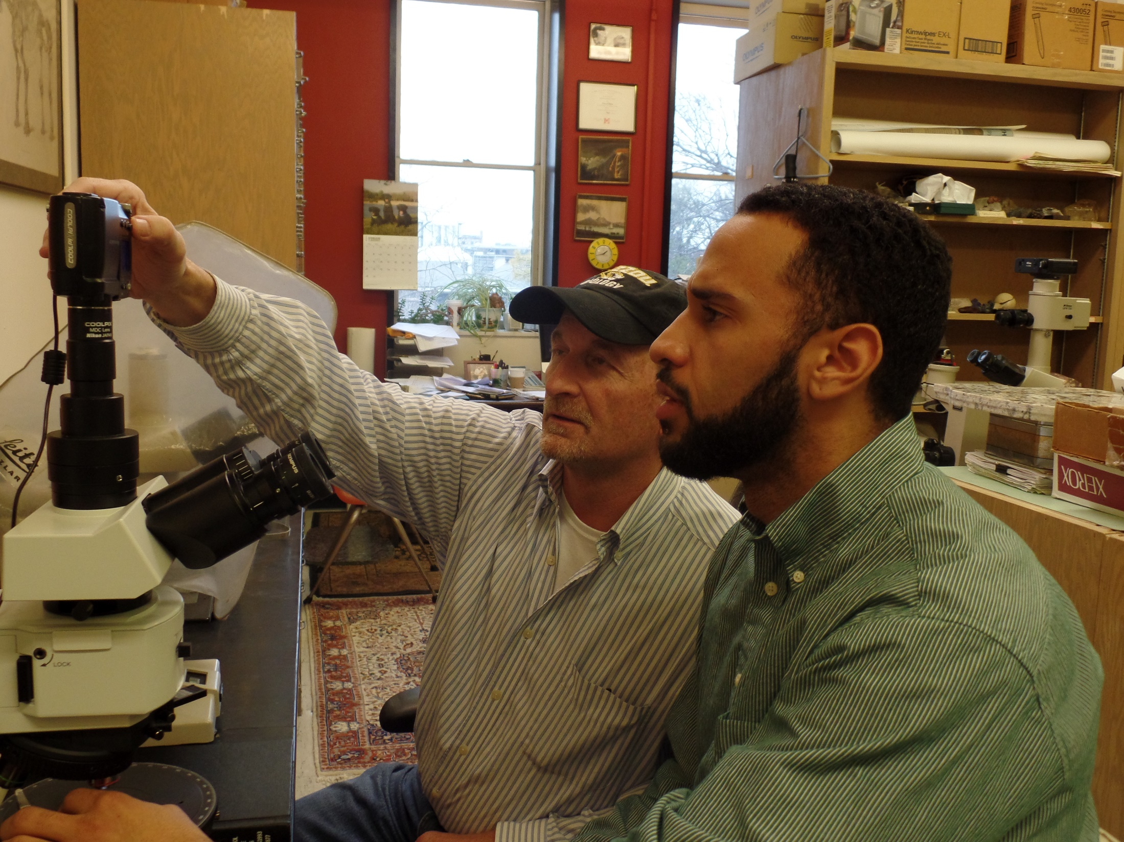
Funded Internships
Paid Undergraduate Research with a Faculty mentor
Conduct research in your field
All Majors accepted
280 hours of research per academic year

Slide 7
Faculty Mentorship
“I really wasn’t sure what to expect but [my mentor] really ended up being my foundation for my final semesters.
He taught me, guided me and generally provided advice regarding graduate schooling and research. He was great and I don’t think I could have had a better mentor. Here’s hoping the next is even half as great!”
--2017-2018 McNair Scholar

Slide 8
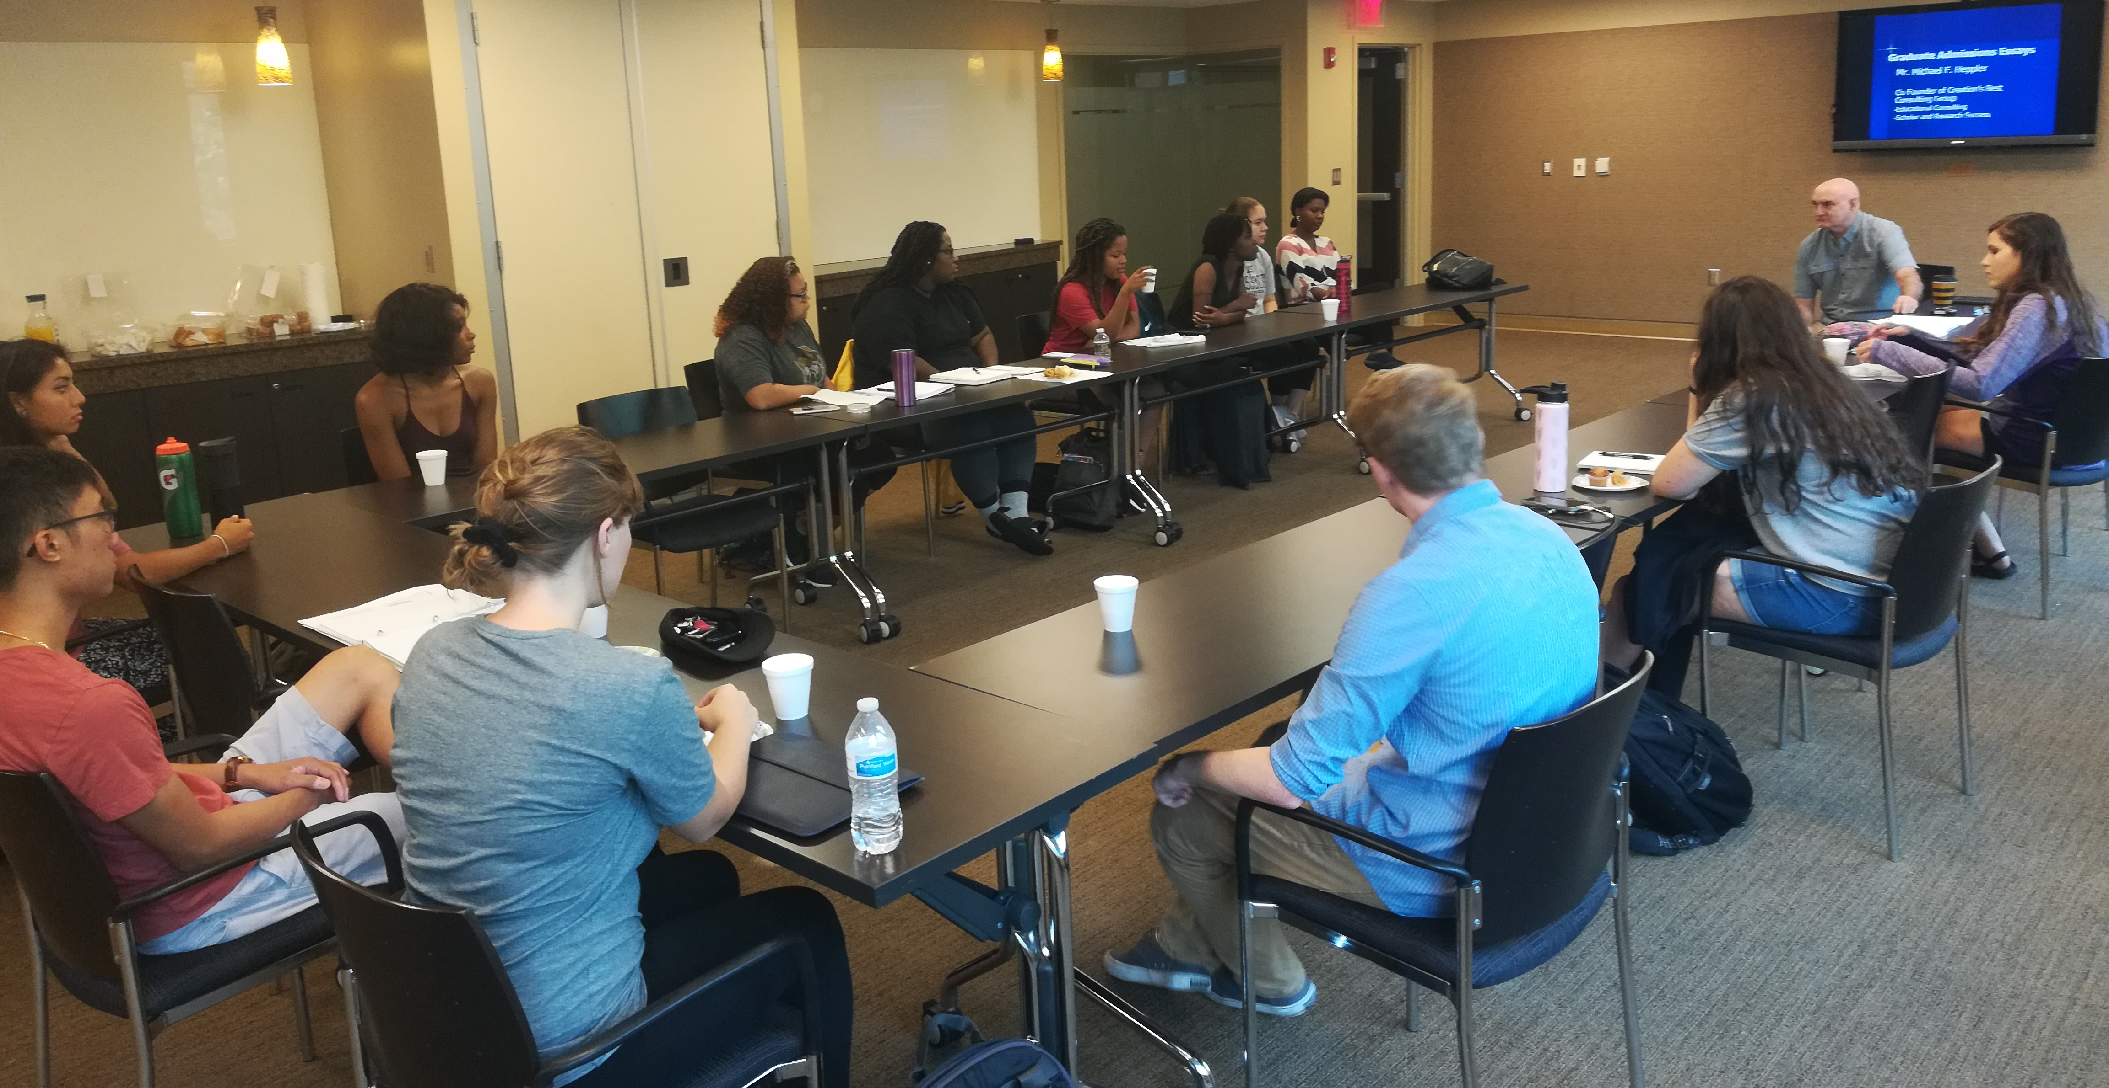
Workshop Series
Graduate School Preparation
Applying to graduate school
Personal Statements
Senior Retreats
Funding graduate school
Writing Research
Proposal, Literature Review, Methods, Results, Conclusions/Discussion
Presenting Research

Slide 9
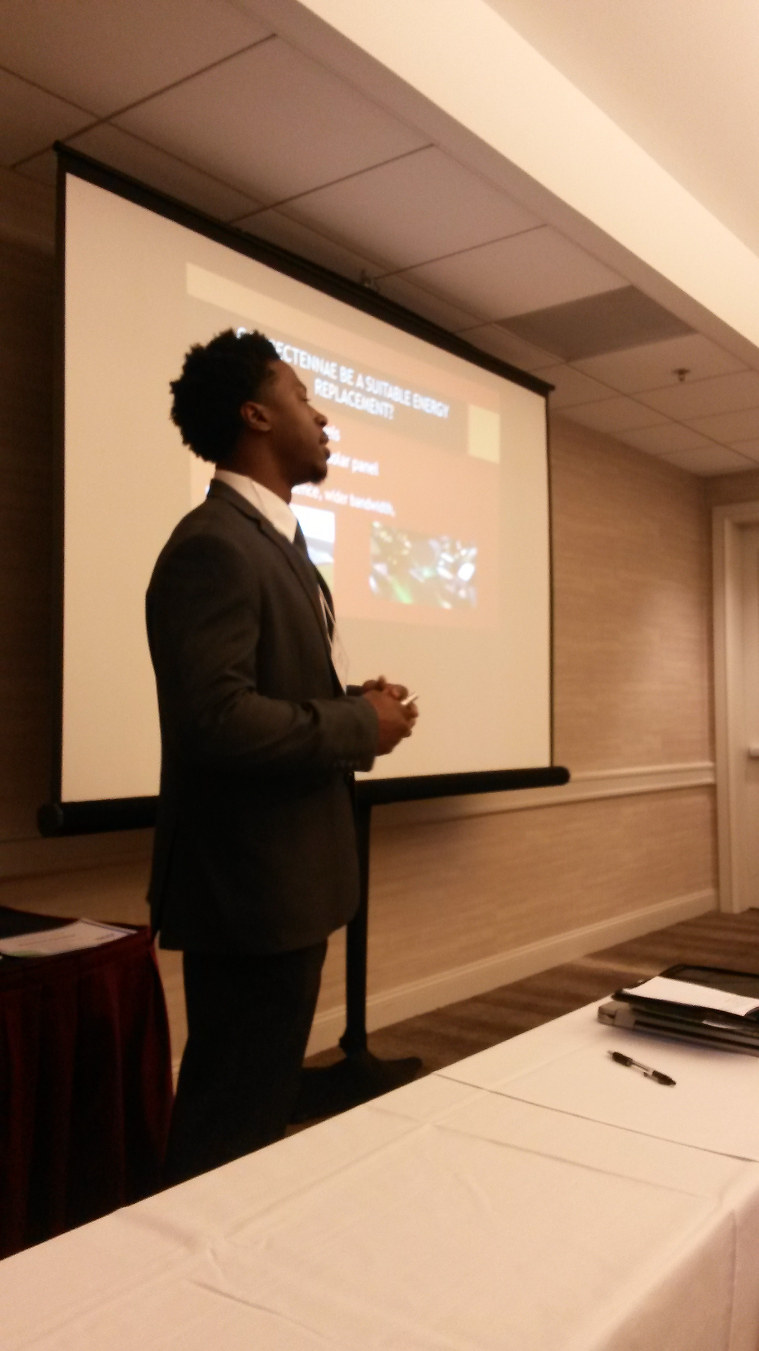
Conference Travel
Paid travel to professional conference with your mentor
Present your research to a larger audience
See experts in your field present
Networking for graduate school
Recent Locations:
Portland, New Orleans, San Francisco, New York, St. Louis, Chicago

Slide 10
GRE PREP
Test required for most graduate programs
50% off the GRE test
GRE Preparation Classes
Hybrid of in person meetings and online
Available to scholars as a senior or a junior
Takes place in September preparing scholars to take the test in October or November

Slide 11
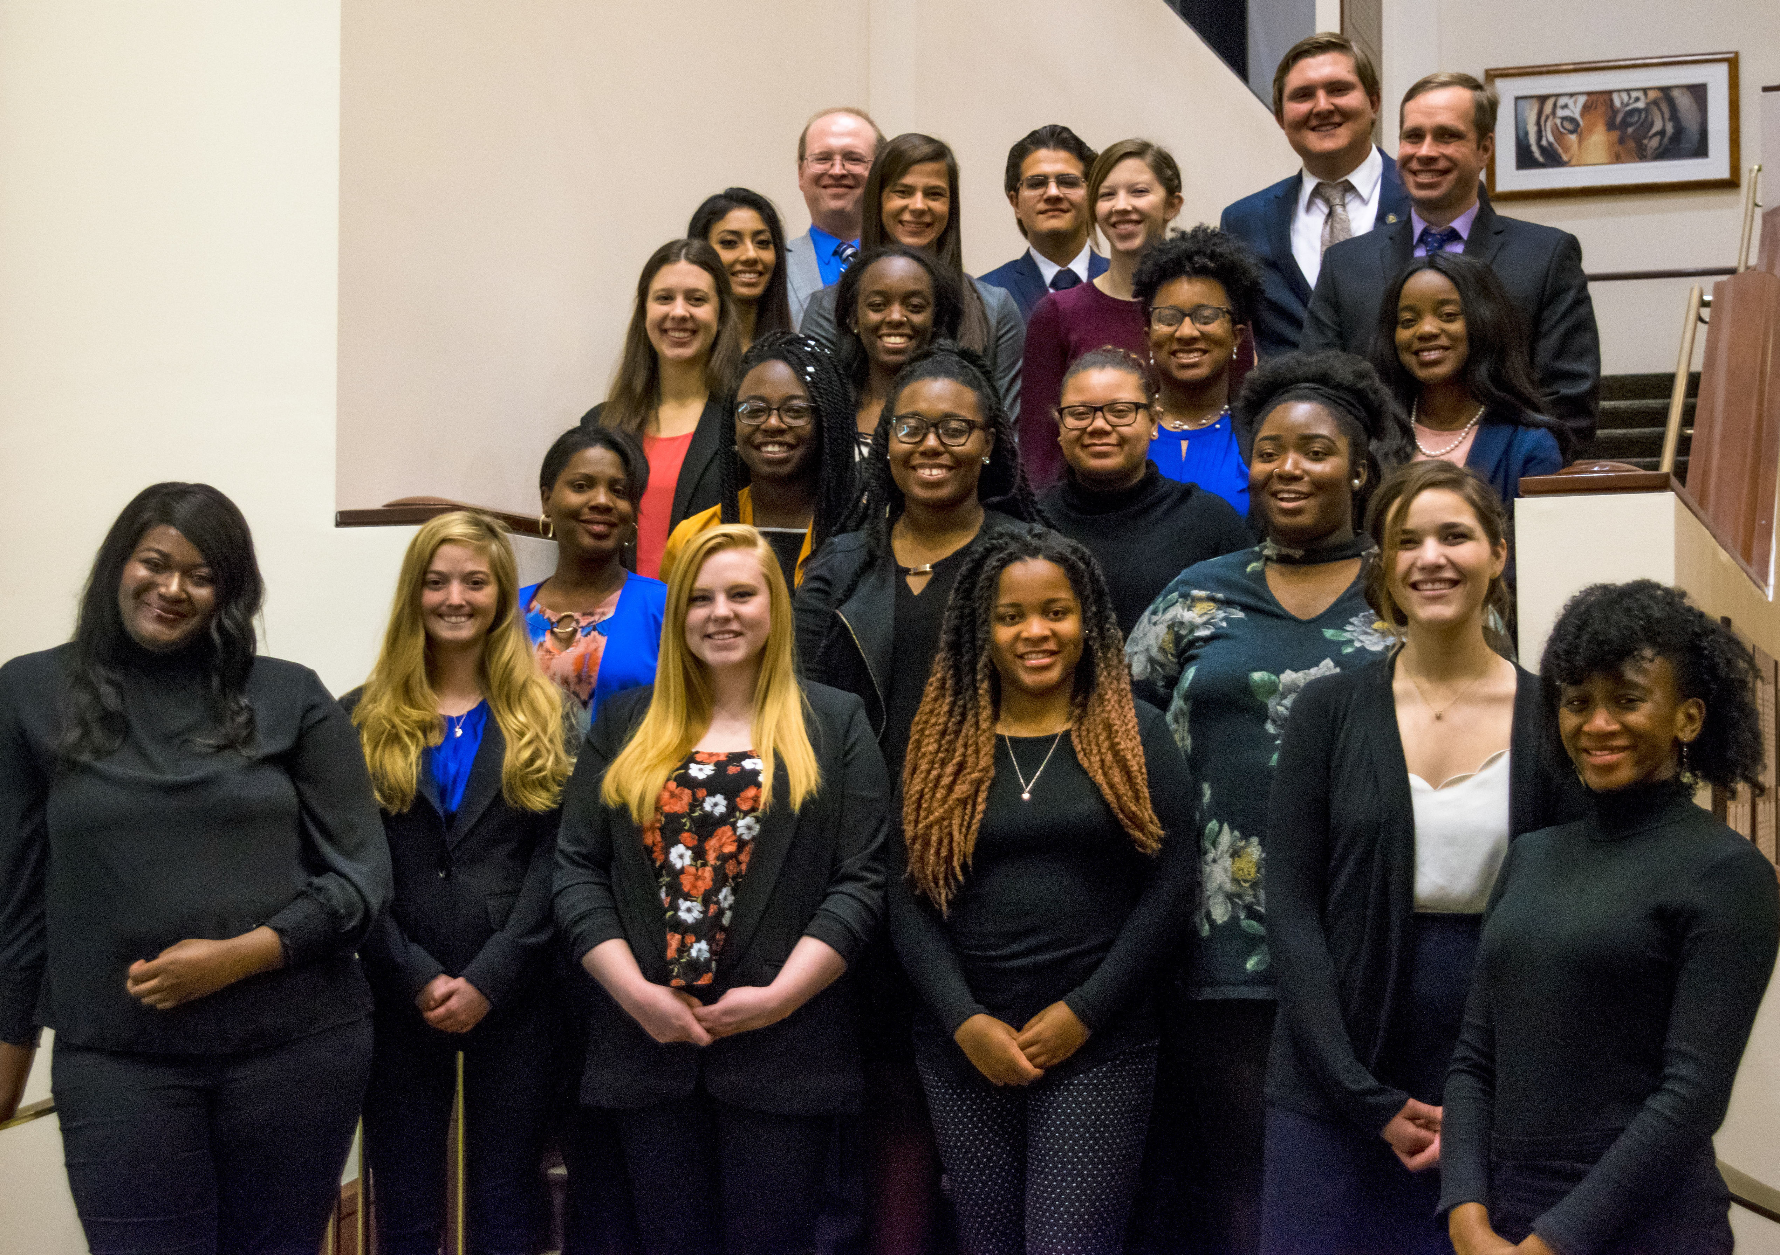
Other Benefits
Application fee waived to graduate schools
McNair specific fellowships
Free MU Transcripts
Strong letters of recommendations
Curriculum Vitae Assistance
Preparing to be a T.A. Class
Graduate school campus visits

Slide 12
Mizzou Successes
189 MU McNair Scholars have obtained their doctoral degree
Over 300 obtained at least a master’s
Since 2012 there have been 46 doctoral degrees granted to past scholars
Currently 104 scholars in graduate school

Slide 13
The Application
Student Application
Two Letters of Recommendation
Mentor Application (optional, but strongly recommended)
Due February 29th 2024
(Available on McNair Website)
mcnair.missouri.edu

Slide 14
Student Application
Qualtrics form, asking for basic demographic information
Personal Statement (500 words)
Relevant background information.
Your interest in pursuing further academic work in a particular discipline.
Why you want to participate in the program.
A description of your research interests and, if possible, proposed research project or scholarly activity.

Slide 15
Student Application
Academic Profile
Tax information (FAFSA or Parents’ 2023 IRS 1040 form)

Slide 16
Letters of Recommendation
Two recommenders from those who can speak on your academic behalf
Faculty, graduate students, academic advisor, etc.
Prefer those who’ve known you post high school
OK if from other institution
Letters discuss:
Your potential as a graduate student and future scholar
How you may benefit from the McNair Program
Your aptitude for academic research or scholarly activity
Your motivation for completing graduate work
Your strengths and weaknesses

Slide 17
Mentor Application
Identify mentor
Consider mentor fit for your future
Tips on finding
Ok if recommender is also mentor (in fact, we like that!)

Slide 18
Interview
30 finalists
~20 minute long interview with McNair Staff
Expands on personal statement
Emphasizing why you want to go to graduate school
Takes place week before spring break

Slide 19
Selection
Eligibility
2/3rd must be first generation and meet federal income guidelines
1/3rd may be under-represented
Select 18 students (and ~2 alternates)
Typically around 50 students apply
Odds of 1:4 or 1:3 to be selected for the program
Chosen by Friday after Spring Break

Slide 20
Tips
Having a mentor strongly recommended
Meet with McNair staff if you’re having trouble identifying a mentor
Start early!
Talk with past/current scholars
Share your personal statement with others
Ask for recommendation early!

Slide 21
Academic Access & Leadership Development presents
Guaranteed 4.0 Learning System
The Guaranteed 4.0 Learning System is an innovative approach to learning and success! It is a Dallas-based educational consulting firm that specializes in a dynamic framework of learning. Our comprehensive learning enhancement system employs the latest research in cognitive science and ensures academic excellence – both in and out of the formal educational system.

Slide 22
Academic Access & Leadership Development presents
Guaranteed 4.0 Learning System
Guaranteed 4.0 Learning System @ Mizzou
Saturday, February 10
9:30 am – 3:00 pm
Gaines/Oldham Black Culture Center
Breakfast and lunch
provided for participants.
Registration via MU Engage. Space is limited.
“Guaranteed 4.0” does just what the title implies. This educational series details a unique learning method that is guaranteed to deliver a 4.0 GPA. The focus of these seminars is not “how to study”. Rather, we want students to learn how to learn and ultimately achieve a mindset of academic excellence and success.
Using this comprehensive framework, students learn simple techniques such as repetition for long-term information retention, as well as advanced strategies of critical thinking and metacognition. Students leave the seminar empowered and motivated to achieve their 4.0!
www.nomorestudy.com

Slide 23
Academic Access & Leadership Development presents
Guaranteed 4.0 Learning System
Guaranteed 4.0 Learning System @ Mizzou
Saturday, February 10
9:30 am – 3:00 pm
Gaines/Oldham Black Culture Center
Breakfast and lunch
provided for participants.
Registration via MU Engage. Space is limited.
“Guaranteed 4.0” does just what the title implies. This educational series details a unique learning method that is guaranteed to deliver a 4.0 GPA. The focus of these seminars is not “how to study”. Rather, we want students to learn how to learn and ultimately achieve a mindset of academic excellence and success.
Using this comprehensive framework, students learn simple techniques such as repetition for long-term information retention, as well as advanced strategies of critical thinking and metacognition. Students leave the seminar empowered and motivated to achieve their 4.0!
www.nomorestudy.com

Slide 24
Final Thoughts
“The McNair program was incredible and I will be encouraging any and all undergraduates from first-generation or minority backgrounds to apply whether they have research in mind or not.
I met some of my greatest friends in college in this program and ultimately it helped sculpt me into someone ready for graduate school and also gave me the final concept of what I want to do in graduate school. I cannot wait.”
-- 2015-2016 McNair Scholar

